Slide 1
AI in Optimum C&C:
Room temperature prediction with AI
Sep 2020
Alexandru Lungu, Full-Stack developer, AI enthusiast

Slide 2
Optimum C&C
Room temperature prediction with AI
Introduction
The input: timeseries dataset
The Output: room temperature prediction
Prediction Evaluation (Quality metrics)
Other prediction model (XGBoost)
Conclusion + Model Algorithms (free & open source)

Slide 3
Optimum C&C
Room temperature prediction with AI
Introduction
We want to predict the room temperature, using :
Weather features (temperature/humidity/wind speed/cloudy, etc…)
BMS features (setpoint/schedule/cooling/heating sensors, etc…)

Slide 4
Optimum C&C
Room temperature prediction with AI
Advantages of using the Prophet AI timeseries predictor model:
good model for input data that fits yearly/weekly/daily seasonality plus special events like holidays
Support for recurring events (public holiday, weekends, days with special offers, Blackfriday, football championship, etc)
use other features(from building or outside building, or computed/predicted ones) as dependent features that will improve the prediction
Obs: For input features, we need past and future data (required for any predictor available on market)

Slide 5
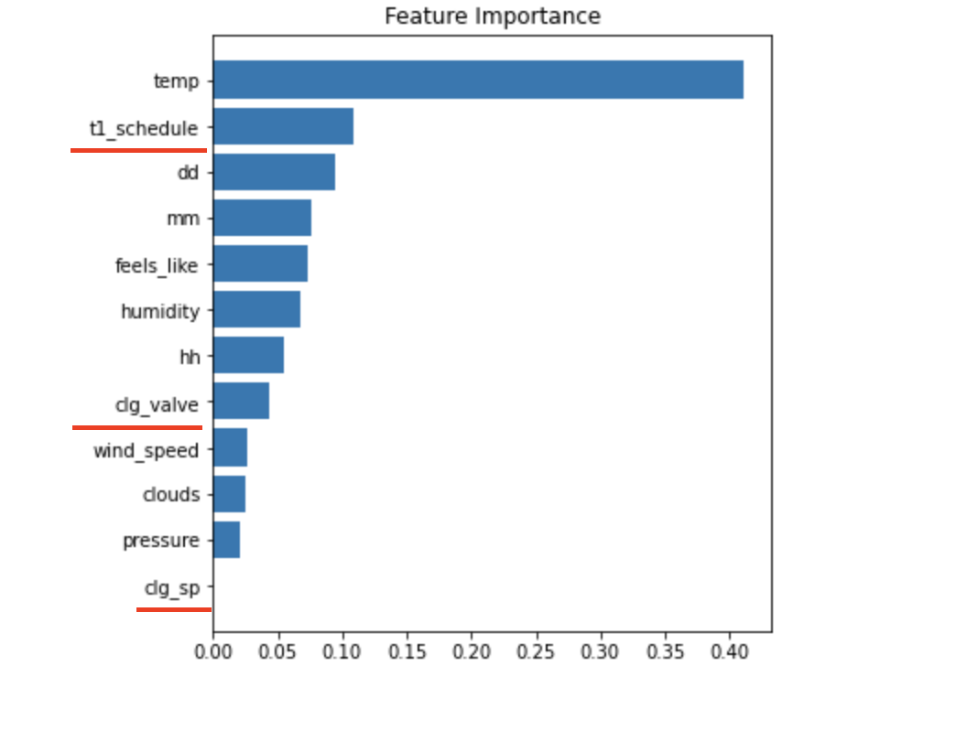
Optimum C&C
Room temperature prediction with AI
2. The input: timeseries dataset

Slide 6
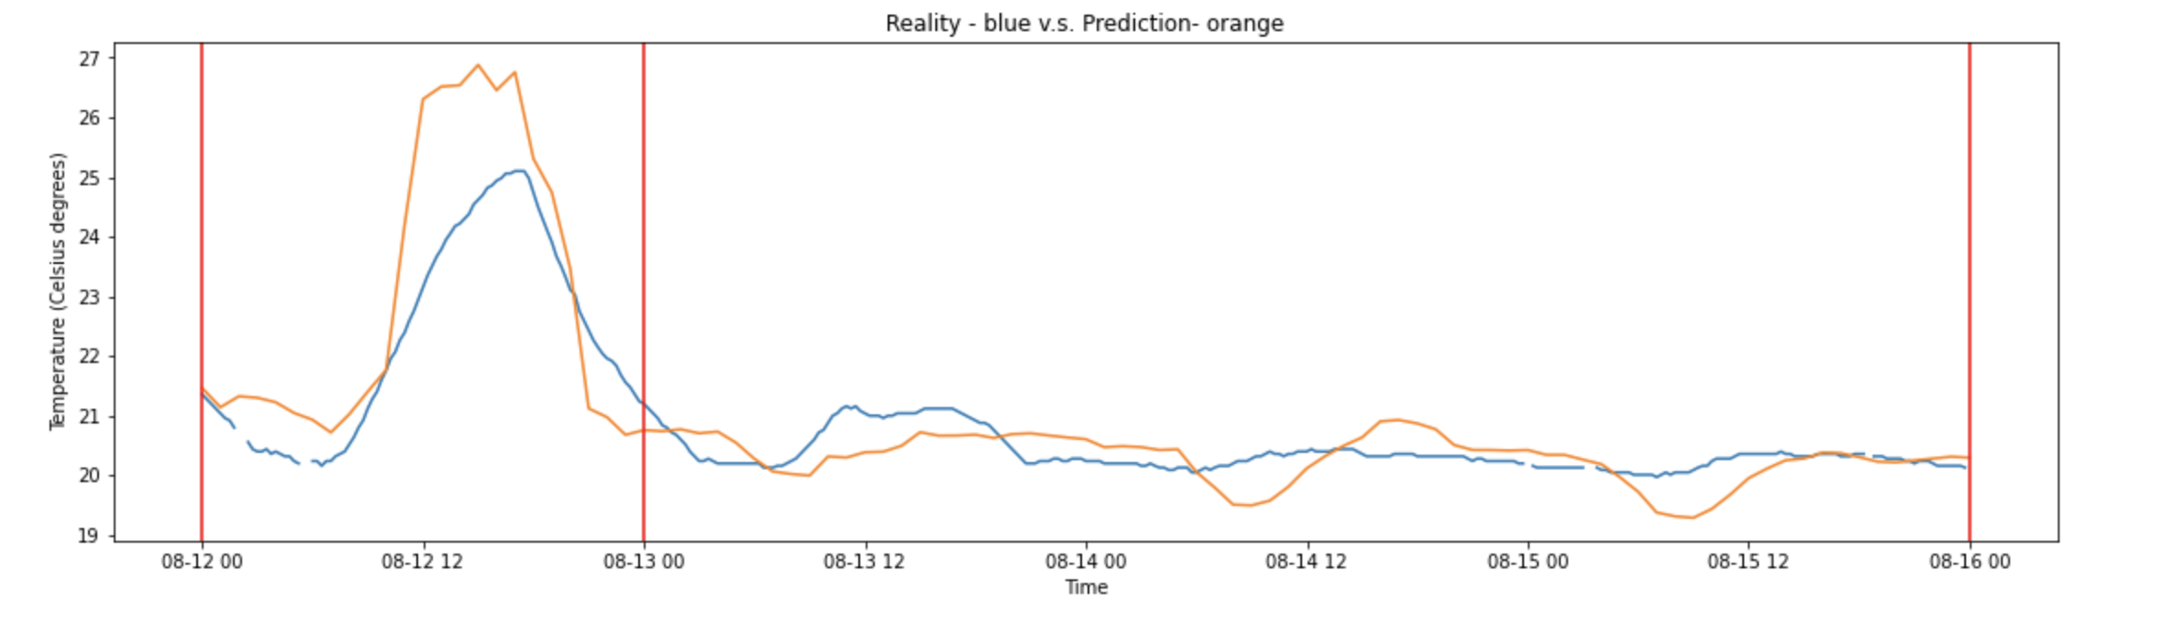
Optimum C&C
Room temperature prediction with AI
3. The Output: room temperature prediction:

Slide 7
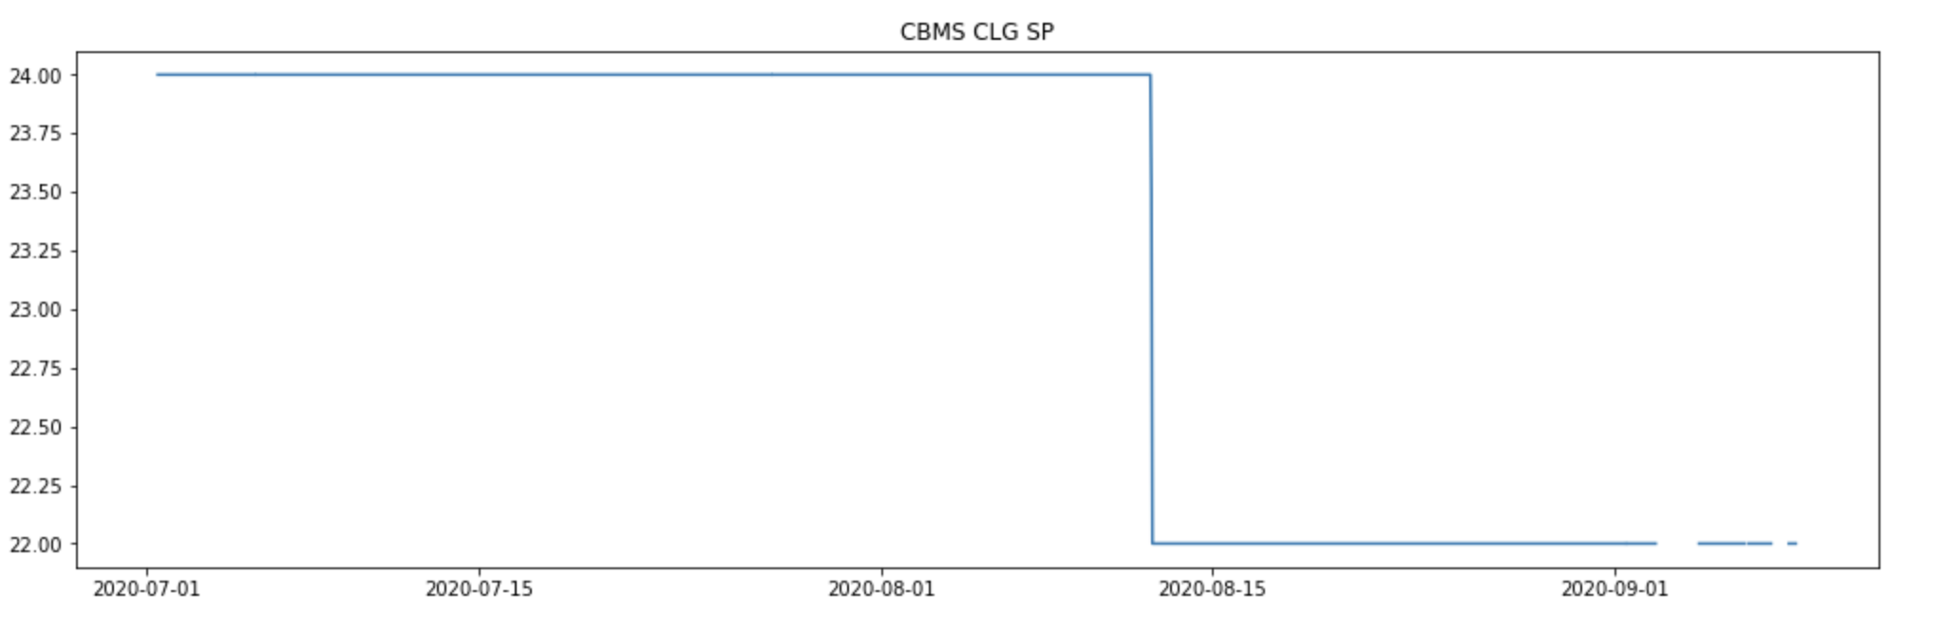
Optimum C&C
Room temperature prediction with AI
3. The Output: room temperature prediction:

Slide 8
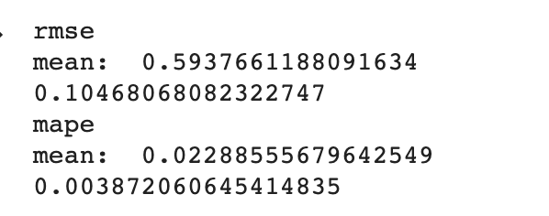
Optimum C&C
Room temperature prediction with AI
4. Prediction Evaluation (Quality metrics)

Slide 9
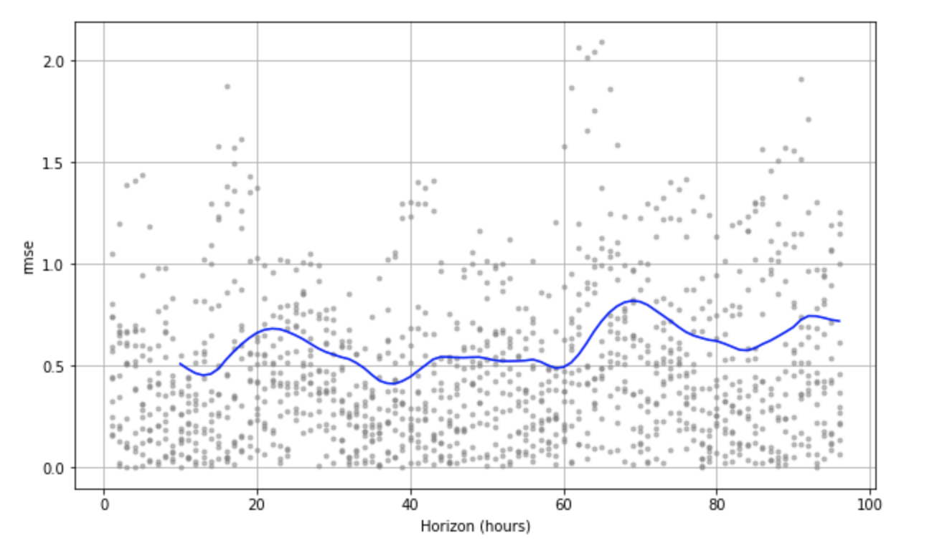
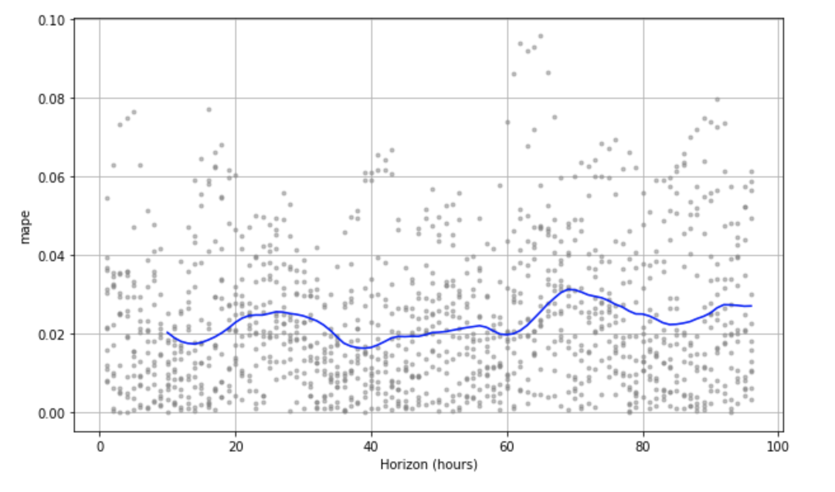
Optimum C&C
Room temperature prediction with AI
4. Prediction Evaluation (Quality metrics) : RMSE and MAPE

Slide 10
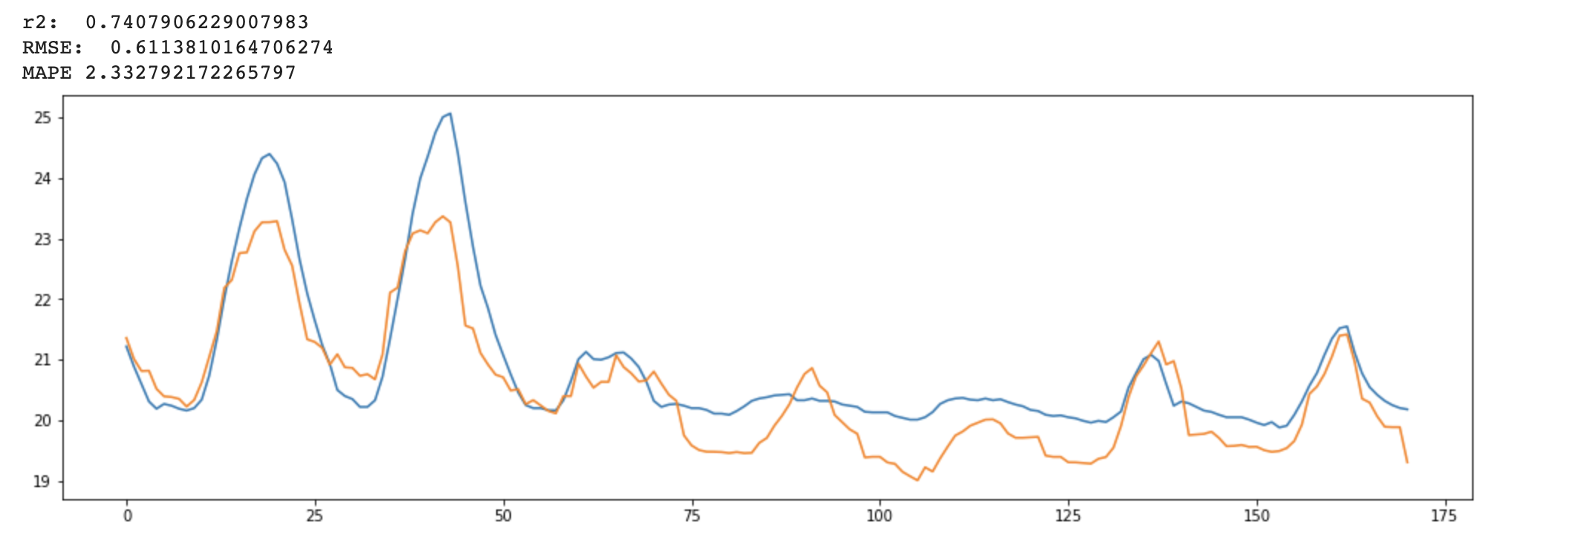
Optimum C&C
Room temperature prediction with AI
5. Other prediction model (XGBoost):

Slide 11
Optimum C&C
Room temperature prediction with AI
6. Conclusion
Model Algorithms (free & open source):
XGBoost: Random forest decision trees
Prophet Model: A generalized additive model (GAM) is a Generalized Linear Model (GLM) in which the linear predictor depends linearly on predictor variables and smooth functions of predictor variables. (https://facebook.github.io/prophet/ https://peerj.com/preprints/3190/ )
XGBoost is the top predictor on the market but requires more intervention from the programmer because it is too generic.

Slide 12
Optimum C&C
Room temperature prediction with AI
6. Conclusion
The model that we’ve selected has similar quality metrics against the XGBoost model. Because the Prophet model has out of the box support for timeseries and recurrent events (e.g holidays), we will choose Prophet AI model

Slide 13
Optimum C&C
Room temperature prediction with AI
6. Conclusion
Now we’ve used also weather and BMS sensor as input (recommended) with good prediction quality factor. For simpler cases (maybe a store has less sensors), we can use only the weather predictions(may produce less accurate predictions)
Even we found a good candidate for the prediction model, the current investigation is not done, we still need to check the model against more BMS sensors and to understand the impact/relations of the BMS sensors against the model (some of the computations were made in testing mode, with only historical data). We need more investigations, and for that we need more data and more sensor interactions.

Slide 14
Questions?
Comments?
Feedback?

Slide 15
Thank you!

